Slide 1

FitifyX: Revolutionizing Social Fitness Challenges
TEAM HACKFIT
Presented by:
Poorvaa Sri B
Yukesh K
Pavithraa D

Slide 2
Introduction & Motivation
Project Idea
Why This Project?
Impact & Relevance
FitifyX is a dynamic social fitness challenges platform designed to motivate users through engaging challenges, community interaction, and gamified rewards. We aim to transform individual fitness journeys into a collaborative and enjoyable experience.
Growing demand for interactive fitness solutions.
Foster healthier lifestyles globally.
Promote community and friendly competition.
Address common challenges: lack of motivation, inconsistent routines.
Utilize modern web technologies for a seamless user experience.
Leverage social connection for positive reinforcement.

Slide 3

Problem Statement: The Motivation Gap
Despite widespread awareness of fitness benefits, many individuals struggle with maintaining consistent exercise routines due to a lack of motivation, social support, and engaging incentives. Existing solutions often fall short in fostering long-term engagement and community interaction.
Potential Users
Fitness enthusiasts seeking new challenges.
Beginners looking for motivation and guidance.
Groups and friends wanting to exercise together.
Individuals needing structure and accountability.

Slide 4
Proposed Solution & Objectives: FitifyX
1
2
3
Overview
Key Objectives
Core Technologies
FitifyX will be a web and mobile-responsive platform offering personalized and public fitness challenges, robust tracking, and interactive social features. It aims to make fitness accessible, fun, and sustainable.
Develop a user-friendly interface.
MongoDB: Flexible NoSQL database for scalable data storage.
Implement secure user authentication.
Express.js: Fast, unopinionated web framework for Node.js backend.
Enable diverse challenge creation and participation.
React.js: Declarative JavaScript library for building dynamic user interfaces.
Integrate with popular fitness trackers.
Node.js: JavaScript runtime for server-side logic and APIs.
Build social sharing and leaderboard functionalities.

Slide 5




Technology Stack Justification: Why MERN?
Unified Language
Full-Stack Development
JavaScript for both frontend and backend streamlines development, enabling faster iteration and easier team collaboration. This reduces context switching and improves developer efficiency.
MERN provides a complete stack from database to client, offering robust tools for every layer of the application. This full-stack capability ensures cohesive and integrated development.
Scalability & Performance
Rich User Experience
Node.js's non-blocking I/O and MongoDB's flexible schema handle high traffic and diverse data types efficiently, crucial for a growing user base and dynamic fitness data.
React.js facilitates interactive and responsive UIs, providing a smooth and engaging experience for challenge tracking, social interaction, and real-time updates.

Slide 6
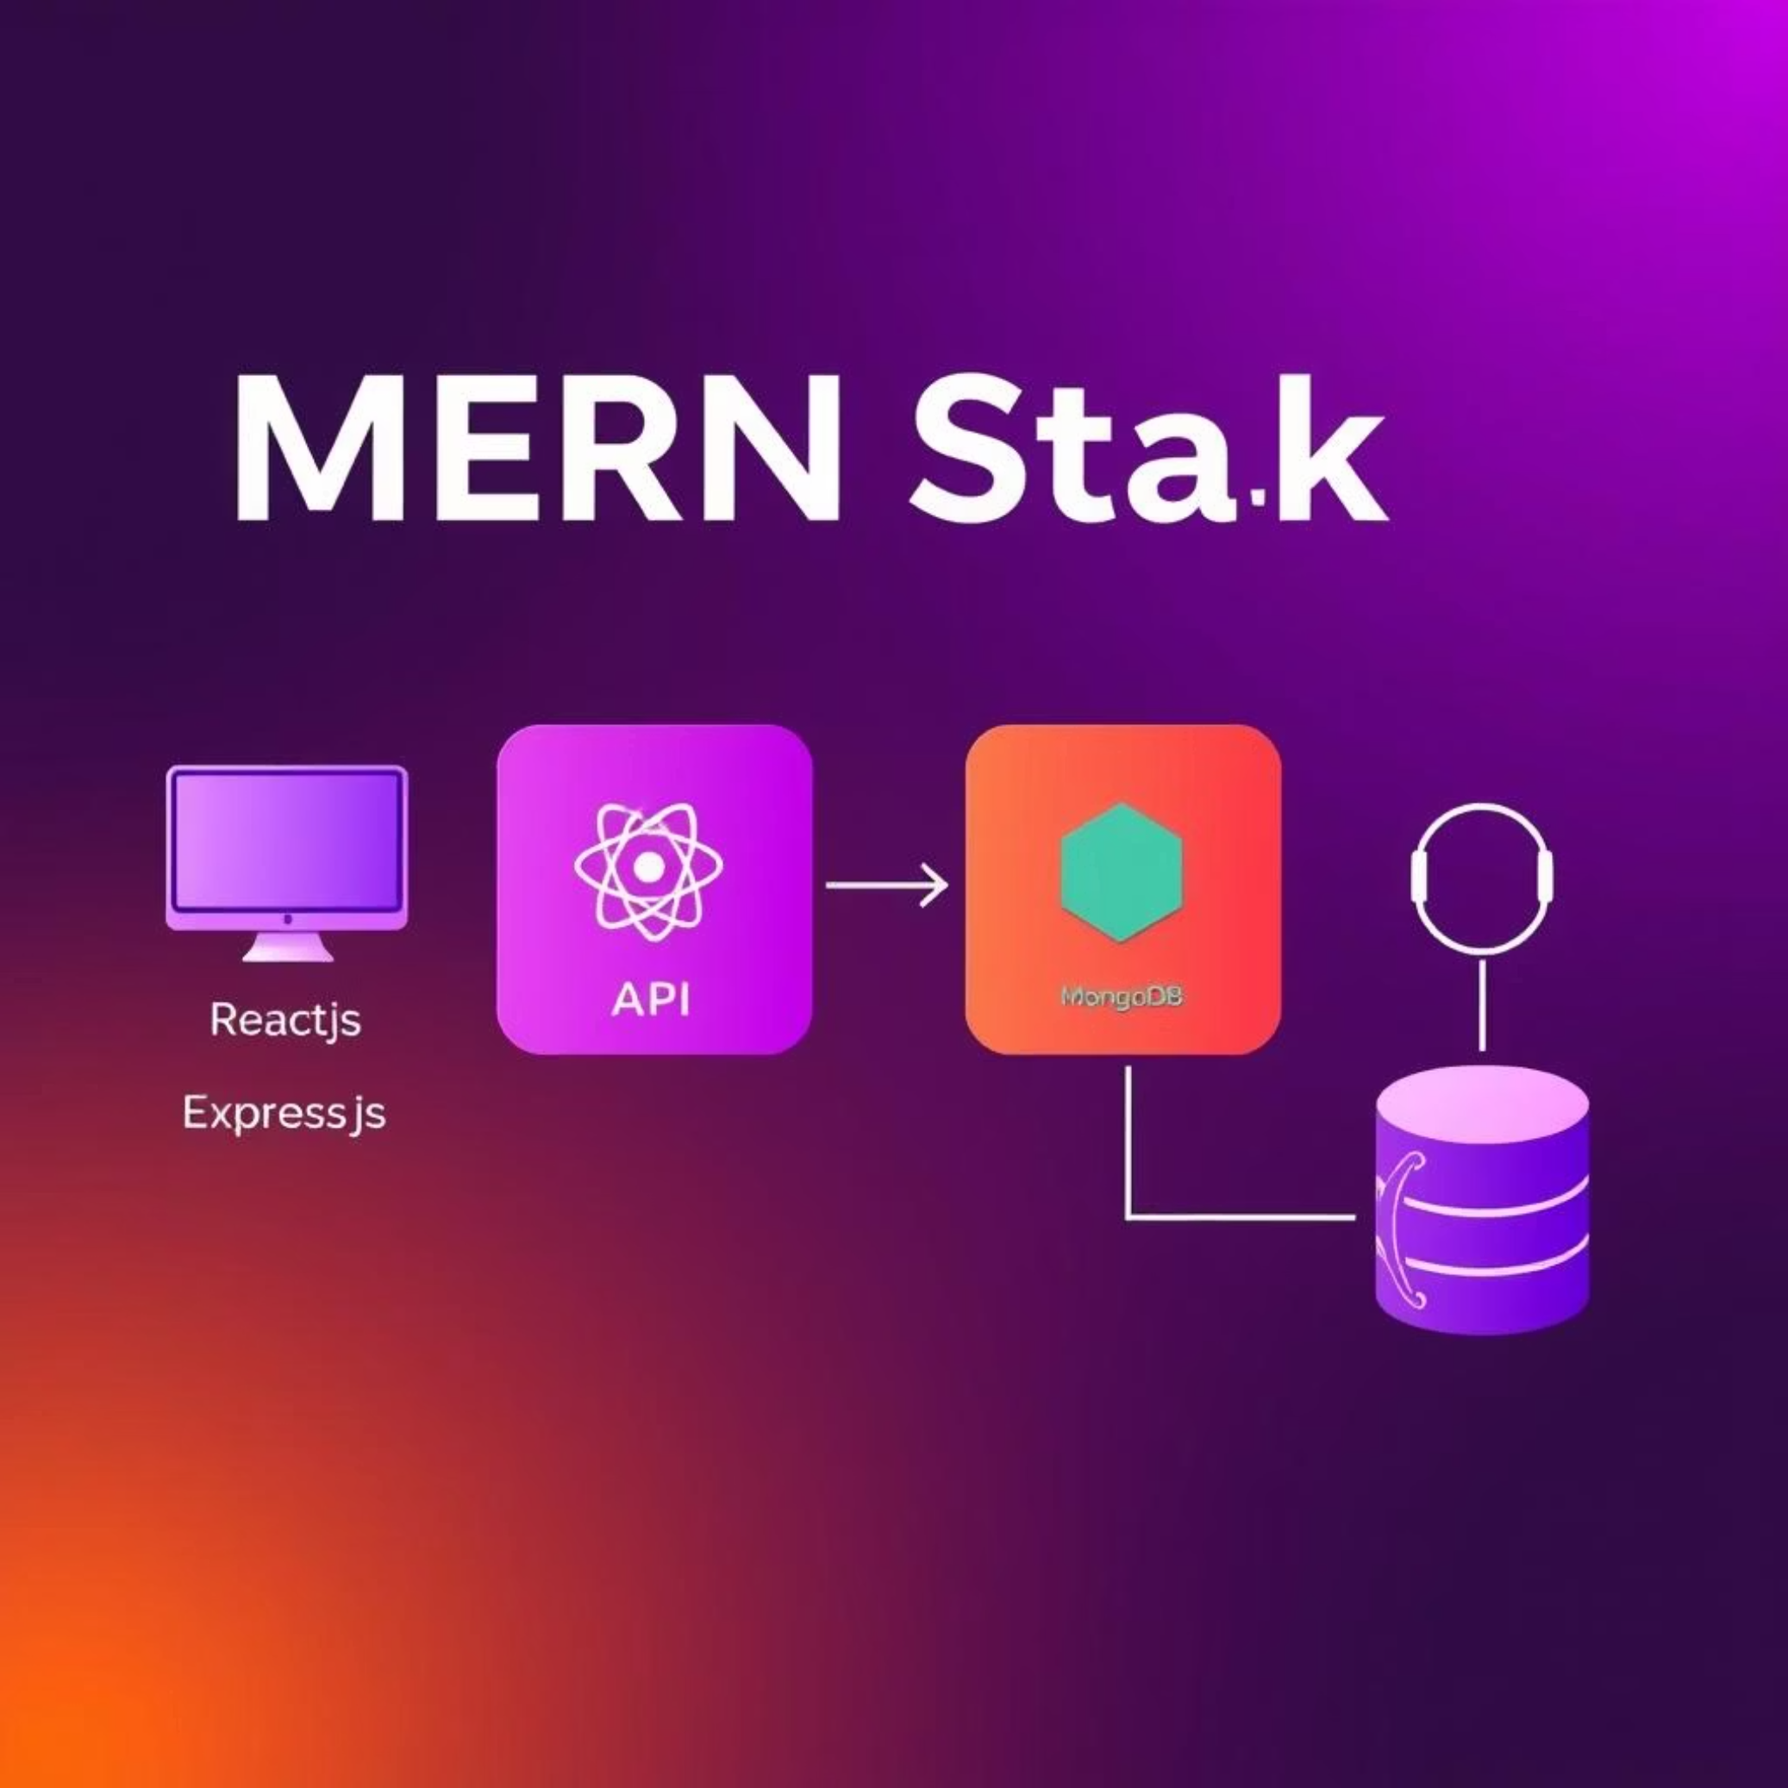
System Architecture Overview
How FitifyX Works
The architecture leverages the MERN stack for a robust and scalable application. React.js handles the client-side interface, sending requests to the Express.js API, which is built on Node.js. MongoDB serves as the database, storing user profiles, challenge data, and fitness metrics.
Third-party fitness tracker integrations (Fitbit, Apple Health) will securely sync data to the backend, ensuring a comprehensive view of user activity. Real-time notifications are managed through WebSockets or similar technologies for immediate updates.

Slide 7
Key Modules & Features
User & Profile Management
Challenge Creation & Participation
Activity Tracking & Integration
Secure sign-up/login.
Track steps, calories, distance, workouts.
Customizable profiles (photos, goals, activities).
Personalized fitness challenge creation.
Integration with Fitbit, Apple Watch, Google Fit.
Password reset and account recovery.
Browse and join public challenges by activity/difficulty.
Manual data entry option.
Team challenges for group goals.
Social & Gamification
Notifications & Analytics
Share results on social media.
Real-time push notifications for milestones and reminders.
Follow friends and track progress.
Customizable notification preferences.
Dynamic leaderboards with daily/weekly/monthly rankings.
Detailed performance insights, historical data, and trends.
Gamified rewards: badges, titles, points, virtual currency.

Slide 8

Expected Outcomes & Benefits
For Users
Increased motivation and consistency in fitness.
Engaging social interaction and community support.
Personalized fitness journeys.
Access to diverse challenges and activities.
Tangible rewards for achieving goals.

Slide 9
Timeline & Milestones
1
2
Phase 1: Planning & Setup (Weeks 1-3)
Phase 2: Core Development (Weeks 4-10)
Detailed project planning and wireframing.
User authentication and profile management.
Database schema design.
Challenge creation and joining features.
MERN stack environment setup.
Basic activity tracking implementation.
3
4
Phase 3: Integration & Social Features (Weeks 11-16)
Phase 4: Testing & Deployment (Weeks 17-20)
Comprehensive testing (unit, integration, user acceptance).
Fitness tracker integrations.
Bug fixing and performance optimization.
Social sharing and leaderboard implementation.
Deployment to cloud platform (e.g., Vercel, Render).
Gamified rewards system.

Slide 10
Conclusion & Future Scope
Conclusion
Future Enhancements
FitifyX aims to address the common struggle of fitness motivation by offering a gamified, social, and personalized platform built on the robust MERN stack. By integrating core features with innovative ideas, we expect to create a highly engaging and effective fitness solution.
Augmented Reality (AR) Challenges: Interactive running or reward checkpoints.
AI-Based Personalization: Recommended challenges based on user data.
Virtual Races & Events: Global participation in virtual fitness events.
In-App Fitness Coach: AI-driven guidance and customized workout plans.
Collaborative Charity Challenges: Link fitness goals to charitable donations.

